Slide 1
Chapter 9 Book
Nuclear Changes
#19 (what is radiation)

Slide 2
I. Nuclear Radiation
Radioactivity
  Nucleus emits one or more particles
  Unstable nuclei
Unstable
  Nuclei has to many or to few neutrons
Nuclear Radiation
  Release of particles from the nucleus during radioactive decay

Slide 3
Nuclear Decay
  Process of nuclear change in an atom of radioactive material
  Results in an isotope of the same element or in an entirely different element
Ionization
  Lose or gain of electrons
Background radiation
  Can come from the sun, water, plants, etc…..

Slide 4
Different Types of Nuclear Radiation video #20(nuclear chem CC) --(table 1 pp285)
Alpha Particle (α)
  Positively charged
  Weak: barely pass through a sheet of paper
  Alpha Decay
    _{217 A 4}
    ₈₉ ^{Ac →} _{Z} ^{X +} ₂ ^{He}
    Atomic mass
      Element
      Atomic number

Slide 5
Beta Particles ( β)
  Negative charge
  Stopped by 3 mm of aluminum or 10 mm of wood
  Beta Decay
    Neutron → Proton + Electron (which is emitted)
    _{14 A 0}
    ₆ ^{C →} _{Z} ^{X +} ₋₁ e

Slide 6
Gamma Rays (γ)
  No electrical charge
  60 cm of Al or 7 cm of Pb
  Health Hazard
Neutron Emission
  No electrical charge
  15 cm of Pb

Slide 7
II. Nuclear Forces
Strong Nuclear Force
  Force that keeps the nucleus together
  Acts only over a very short distance
  Fig. 6 pp 294
  Video #21(nuclear chem part 2:CC)

Slide 8
A. Nuclear Fission
Nuclear Fission
  Splitting the nucleus
  Uranium is the most common fuel (pp 295; fig 7)
  E = mc²
    3.0 X 10⁸ m/s

Slide 9
Nuclear Chain Reactions
  (Fig 8 pp296) continuous series of nuclear fission reactions
  Critical mass
    Minimum mass that provides the number of neutrons needed to sustain a chain reaction
  Graphite Rods
    Slow reaction down by absorbing neutrons

Slide 10
Main problem is disposal of the waste
Waste has a long half-life
  Half-life: time required for half a sample of radiation nuclei to decay
Storage of radioactive-waste
  Sparsely populated areas
  Area free from earthquakes
  Far away from ground water

Slide 11
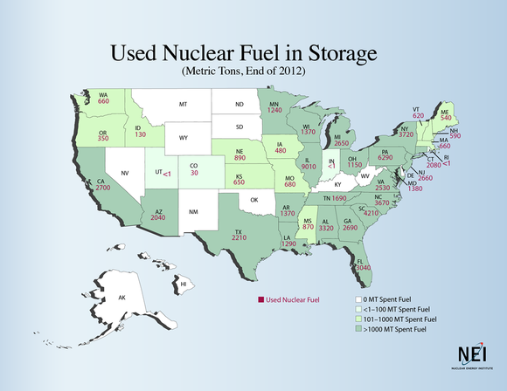

Slide 12
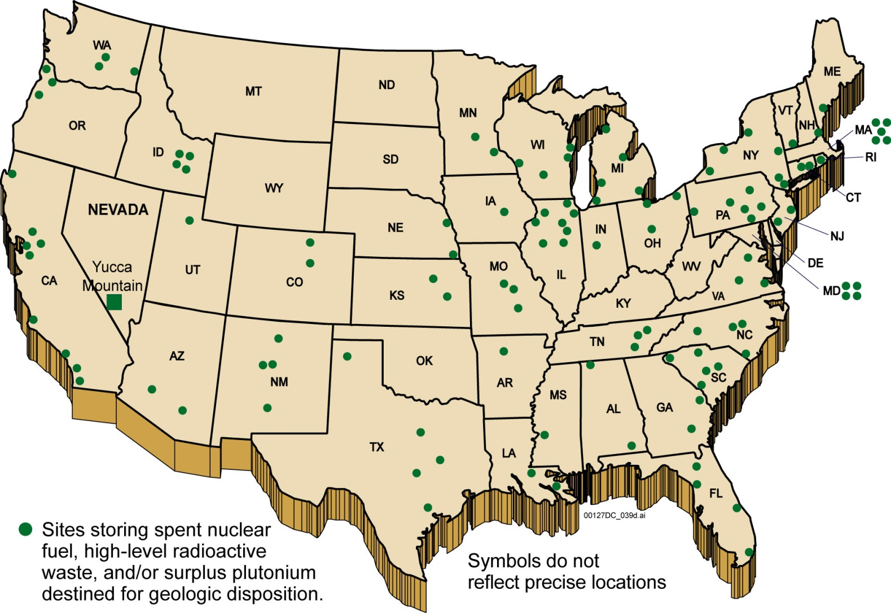

Slide 13
SOURCE: NUCLEAR ENERGY INSTITUTE.
*CALIFORNIA'S TOTAL WAS UPDATED AS OF DEC. 31, 2012 AND IS HIGHER THAN WHAT APPEARS ON THE MAP. SORRY, CALIFORNIA
State | Metric tons of UNF
Illinois | 9,010
Pennsylvania | 6,290
South Carolina | 4,210
New York | 3,720
North Carolina | 3,670
Alabama | 3,320
Florida | 3,040
California | 2,970*
Georgia | 2,690
New Jersey | 2,660
.

Slide 14
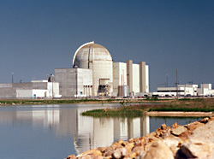

Slide 15
Location: Burlington, KS (3.5 miles NE of Burlington, KS) in Region IV
Operator: Wolf Creek Nuclear Operating Corp.
Operating License: Issued - 06/04/1985
Renewed License: Issued - 11/20/2008
License Expires - 03/11/2045
Docket Number: 05000482
Reactor Type: Pressurized Water Reactor
Licensed MWt: 3,565
Reactor Vendor/Type: Westinghouse Four-Loop
Containment Type: Dry, Ambient Pressure

Slide 16
Benefits of Nuclear radiation
  Smoke detectors
  Treat cancer
  Radioactive tracers
Dangers of Nuclear radiation
  Ionize living tissue
  Cause lung cancer
  Sterility
  Bone necrosis

Slide 17
B. Nuclear Fusion
Nuclear fusion
  Combining nuclei under extreme heat
  2 hydrogen come together to form 1 helium
  In the stars (sun)
  Videos #22(seconds from disaster)-27(spent fuel)
  Videos#52(Taylor Wilson) – 56(where do we store)

