Slide 1
Chapter 7-1, 7-2

Slide 2
A. Kinetic Molecular Theory
Particles in an ideal gas…
  have no volume.
  have elastic collisions.
  are in constant, random, straight-line motion.
  don’t attract or repel each other.
  have an avg. KE directly related to Kelvin temperature.

Slide 3
A. Kinetic Molecular Theory
Particles in an ideal gas…
  have no volume.
  have elastic collisions.
  are in constant, random, straight-line motion.
  don’t attract or repel each other.
  have an avg. KE directly related to Kelvin temperature.

Slide 4
B. Real Gases
Particles in a REAL gas…
  have their own volume
  attract each other
Gas behavior is most ideal…
  at low pressures
  at high temperatures
  in nonpolar atoms/molecules

Slide 5
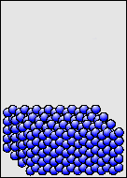
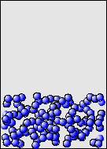
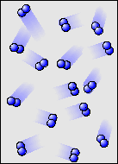
C. Characteristics of Gases
Gases expand to fill any container.
  random motion, no attraction
Gases are fluids (like liquids).
  no attraction
Gases have very low densities.
  no volume = lots of empty space

Slide 6
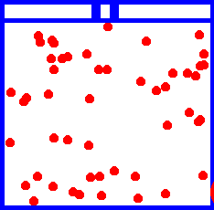
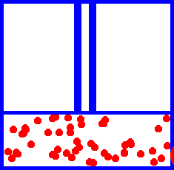
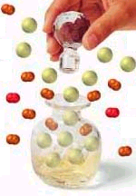
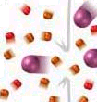
C. Characteristics of Gases
Gases can be compressed.
  no volume = lots of empty space
Gases undergo diffusion & effusion.
  random motion

Slide 7
D. Temperature
Always use absolute temperature (Kelvin) when working with gases.
ºF
-459
32
212
ºC
-273
0
100
K
0
273
373
K = ºC + 273

Slide 8
E. Pressure
Which shoes create the most pressure?

Slide 9
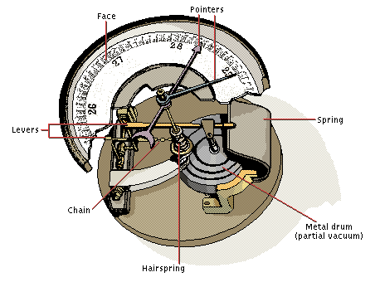
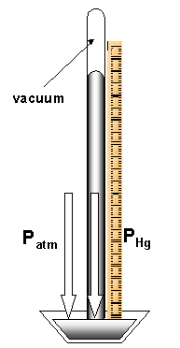
E. Pressure
Barometer
  measures atmospheric pressure
Aneroid Barometer
Mercury Barometer

Slide 10
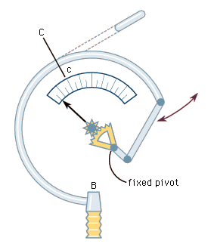
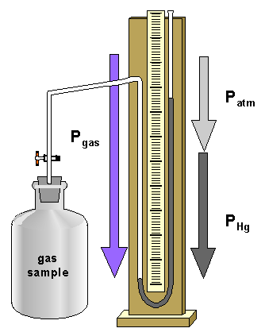
E. Pressure
Manometer
  measures contained gas pressure
U-tube Manometer
Bourdon-tube gauge

Slide 11
E. Pressure
KEY UNITS AT SEA LEVEL
  101.325 kPa (kilopascal)
  1 atm
  760 mm Hg
  760 torr
  14.7 psi

Slide 12
F. STP
STP
Standard Temperature & Pressure
0°C 273 K
1 atm 101.325 kPa
-OR-

