Slide 1
Chapter 7-3

Slide 2
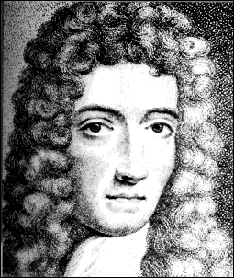
A. Boyle’s Law
PV = k
P
V

Slide 3
A. Boyle’s Law
The pressure and volume of a gas are inversely related
at constant mass & temp
PV = k
P
V

Slide 4
A. Boyle’s Law

Slide 5
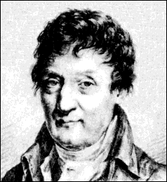
B. Charles’ Law
V
T

Slide 6
B. Charles’ Law
The volume and absolute temperature (K) of a gas are directly related
at constant mass & pressure
V
T

Slide 7
B. Charles’ Law

Slide 8
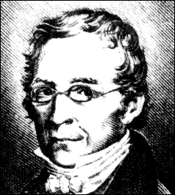
C. Gay-Lussac’s Law
P
T

Slide 9
C. Gay-Lussac’s Law
The pressure and absolute temperature (K) of a gas are directly related
at constant mass & volume
P
T

Slide 10
D. Combined Gas Law
P
T
V
T
PV
T
PV
= k
P₁V₁
T₁
P₂V₂
T₂
=
P₁V₁T₂ = P₂V₂T₁

Slide 11
E. Gas Law Problems
A gas occupies 473 cm³ at 36°C. Find its volume at 94°C.
CHARLES’ LAW
GIVEN:
V₁ = 473 cm³
T₁ = 36°C = 309K
V₂ = ?
T₂ = 94°C = 367K
T↑
V↑
WORK:
P₁V₁T₂ = P₂V₂T₁
(473 cm³)(367 K)=V₂(309 K)
V₂ = 562 cm³

Slide 12
E. Gas Law Problems
A gas occupies 100. mL at 150. kPa. Find its volume at 200. kPa.
BOYLE’S LAW
GIVEN:
V₁ = 100. mL
P₁ = 150. kPa
V₂ = ?
P₂ = 200. kPa
P↑
V↓
WORK:
P₁V₁T₂ = P₂V₂T₁
(150.kPa)(100.mL)=(200.kPa)V₂
V₂ = 75.0 mL

Slide 13
E. Gas Law Problems
A gas occupies 7.84 cm³ at 71.8 kPa & 25°C. Find its volume at STP.
COMBINED GAS LAW
P↑ T↓
V↓
GIVEN:
V₁ = 7.84 cm³
P₁ = 71.8 kPa
T₁ = 25°C = 298 K
V₂ = ?
P₂ = 101.325 kPa
T₂ = 273 K
WORK:
P₁V₁T₂ = P₂V₂T₁
(71.8 kPa)(7.84 cm³)(273 K)
=(101.325 kPa) V₂ (298 K)
V₂ = 5.09 cm³

Slide 14
E. Gas Law Problems
A gas’ pressure is 765 torr at 23°C. At what temperature will the pressure be 560. torr?
GAY-LUSSAC’S LAW
GIVEN:
P₁ = 765 torr
T₁ = 23°C = 296K
P₂ = 560. torr
T₂ = ?
P↓
T↓
WORK:
P₁V₁T₂ = P₂V₂T₁
(765 torr)T₂ = (560. torr)(296K)
T₂ = 216 K = -57°C

Slide 16
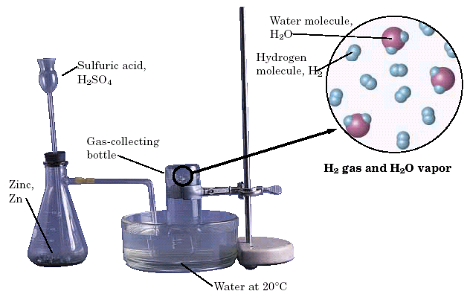
B. Dalton’s Law
The total pressure of a mixture of gases equals the sum of the partial pressures of the individual gases.
P_{total} = P₁ + P₂ + ...
When a H₂ gas is collected by water displacement, the gas in the collection bottle is actually a mixture of H₂ and water vapor.

Slide 17
B. Dalton’s Law
Hydrogen gas is collected over water at 22.5°C. Find the pressure of the dry gas if the atmospheric pressure is 94.4 kPa.
The total pressure in the collection bottle is equal to atmospheric pressure and is a mixture of H₂ and water vapor.
GIVEN:
P_{H2} = ?
P_{total} = 94.4 kPa
P_{H2O} = 2.72 kPa
WORK:
P_{total} = P_{H2} + P_{H2O}
94.4 kPa = P_{H2} + 2.72 kPa
P_{H2} = 91.7 kPa
Look up water-vapor pressure on p.899 for 22.5°C.
Sig Figs: Round to least number of decimal places.

Slide 18
B. Dalton’s Law
A gas is collected over water at a temp of 35.0°C when the barometric pressure is 742.0 torr. What is the partial pressure of the dry gas?
The total pressure in the collection bottle is equal to barometric pressure and is a mixture of the “gas” and water vapor.
GIVEN:
P_{gas} = ?
P_{total} = 742.0 torr
P_{H2O} = 42.2 torr
WORK:
P_{total} = P_{gas} + P_{H2O}
742.0 torr = P_{H2} + 42.2 torr
P_{gas} = 699.8 torr
Look up water-vapor pressure on p.899 for 35.0°C.
Sig Figs: Round to least number of decimal places.

Slide 19
C. Graham’s Law
Diffusion
Spreading of gas molecules throughout a container until evenly distributed.
Effusion
Passing of gas molecules through a tiny opening in a container

Slide 20
C. Graham’s Law
Speed of diffusion/effusion
Kinetic energy is determined by the temperature of the gas.
At the same temp & KE, heavier molecules move more slowly.
Larger m ⇒ smaller v
KE = ½mv²

