Slide 1
http://www.youtube.com/watch?v=ubq4eu_TDFc&list=PLF9969C74FAAD2BF9
#44(genetics 101)

Slide 2
Genetics
Genetics is the study of heredity or how traits are passed on from one generation to another.
Wild type The traits that occur most often in nature.
Some Traits
  skip generations.
  appear more often in one gender than another.
  appear to blend together to produce something in between.

Slide 3
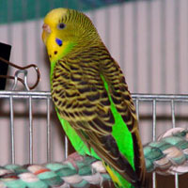
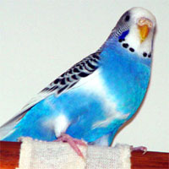
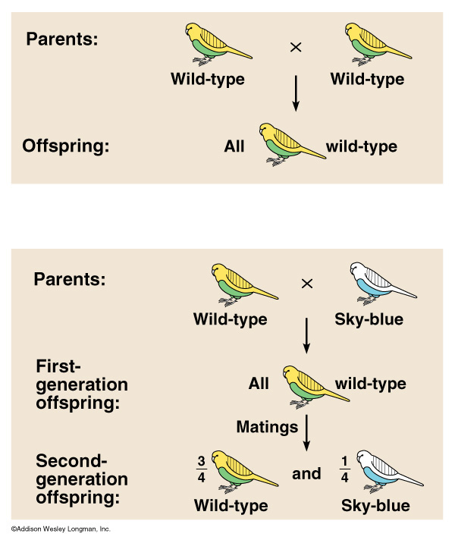
Genetics
Genetics is the study of heredity or how traits are passed on from one generation to another.
Wild type The traits that occur most often in nature.
Some Traits
  skip generations.
  appear more often in one gender than another.
  appear to blend together to produce something in between.

Slide 4
Genetics has Ancient Roots
Pangenesis –
  “genes” for traits came directly from those traits
The Blending Hypothesis
  most common view until modern genetics.
  Offspring were intermediates of parents
Blue birds crossed with yellow birds would produce green birds.

Slide 5
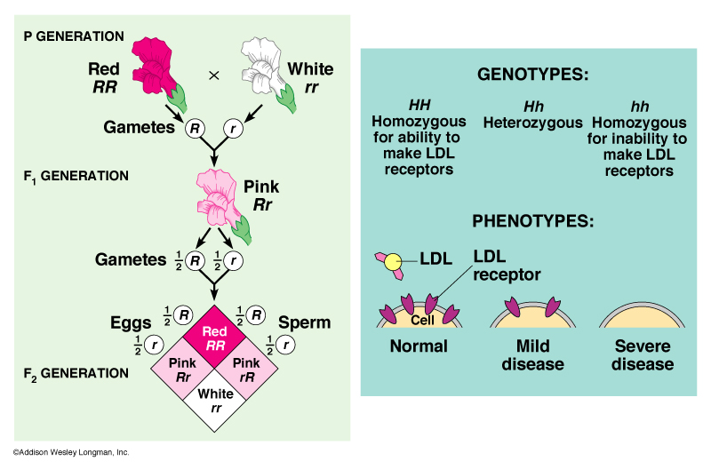
Blending hypothesis
TALL
MEDIUM
X
SHORT
=
X

Slide 6
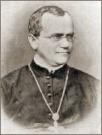
Gregor Mendel
“Father of Modern Genetics”.
He performed experiments on pea plants in the abbey’s garden.
Austrian monk who published a paper in 1866
His paper was not widely recognized until around 1900.

Slide 7
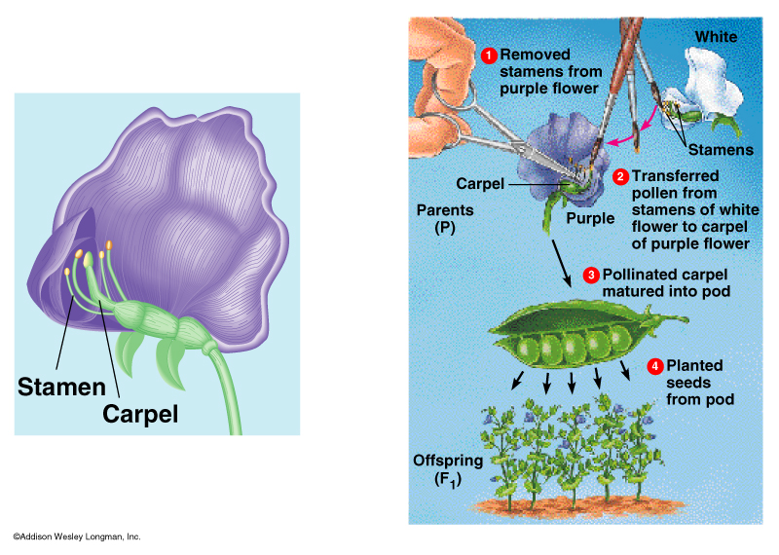
Why Pea Plants?
Mendel was fortunate in selecting the pea plants for his experiments.
Fast reproductive cycle
  observe many offspring from many generations.
Flower structure allowed him to control breeding.

Slide 8
Why Pea Plants?
Pea plants tend to
  Self fertilize, or unite a sperm and ovum (egg) from the same flower.
  Cross fertilization, introducing pollen from a different that he selected.

Slide 9
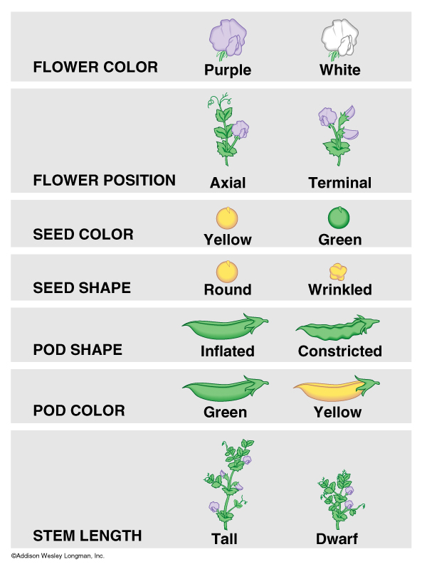
Seven Characteristics
Seven characteristics with distinct traits that were inherited by simple inheritance.
True breeding or purebred plants for that trait.
He produced a hybrid plant by crossing plants that were purebred for different traits.

Slide 10
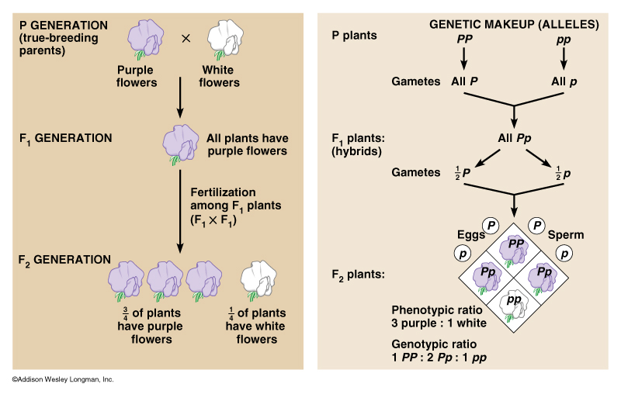
Monohybrid Cross
A monohybrid cross looks at the inheritance of one (mono-) characteristic.
P Generation purebred generation that produce the hybrid.
F₁ generation the offspring of the P generation one trait disappeared.
F₂ generation the offspring F₁ generation was then crossed producing the the trait that disappeared, reappeared in a 3:1 Ratio.

Slide 11
Dominant and Recessive Traits
Dominant trait - the trait that showed up in the F1 generation the
Recessive trait - the trait that disappears in the F1.
Gene - section of a chromosome, controls each of these traits.
Alleles The different forms of the genes that cause the different traits are called.
Alleles are represented, Pp
  capital =dominant allele
  lower case = recessive.

Slide 12
Genotypes and Phenotypes
Genotype refers to the genetic makeup or two alleles that an organism possesses
  Homozygous Dominant HH
  Heterozygous Hh
  Homozygous Recessive hh
Phenotype is the physical trait that is the result of the genotype.
HH, Hh – Dominant hh - recessive

Slide 13
Punnett’s Square: Explain and Predict
The P generation PP x pp.
  Gametes PP = P
  pp = p

Slide 14
P
P
p
P
P
p
p
P
p
P
p
p

Slide 15
Punnett’s Square: Explain and Predict
F₁ generation = Pp or heterozygous. Therefore all have purple flowers.
The gametes produced by an F₁ individual Pp will be half P and half p.

Slide 16
P
p
P
P
P
P
p
P
p
p
p
p

Slide 17
P
p
P
P
P
P
p
Phenotypic Ratio
Purple : White
3 : 1
P
p
p
p
p
Genotypic Ratio
Homozygous D : Heterozygous : Homozygous R
PP: Pp : pp
1 : 2 : 1

Slide 18
T
t
T
T
T
T
t
T
T
T
T
t

Slide 19
T
t
T
T
T
T
t
Phenotypic Ratio
Tall : Short
4 : 0
T
T
T
t
T
Genotypic Ratio
Homozygous D : Heterozygous : Homozygous R
TT: Tt : tt
2 : 2 : 0

Slide 20


Tongue Rolling
Tongue Rolling is a dominant trait in humans
RR or Rr
rr

Slide 21
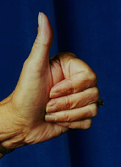
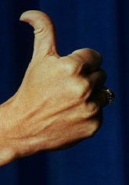
Hitchhiker’s Thumb
Hitchhiker’s thumb is a recessive trait in humans
HH or Hh
hh

Slide 22
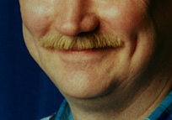
Dimples
DD or Dd

Slide 23
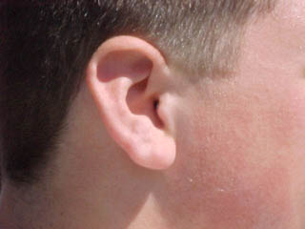
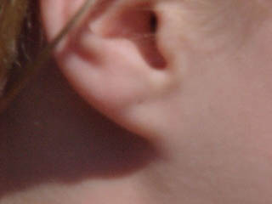
Free vs Attached Earlobes
Free Earlobes are a dominant trait in humans
FF or Ff
ff

Slide 24
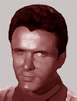
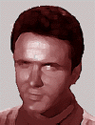
Widow’s Peak
Widow’s Peak a dominant trait in humans
WW or Ww
ww

Slide 25
Both of your parents are heterozygous for freckles. Ff X Ff
Determine the
A. Phenotypic Ratio (Dominant : Recessive) and
B. Geneotypic ratio (AA: Aa : aa) for the following crosses.
A. ______ : _________ B. ______ : _______ : ________

Slide 26
F
f
F
F
F
F
f
F
f
f
f
f

Slide 27
Both of your parents are heterozygous for freckles. Ff X Ff
Determine the
A. Phenotypic Ratio (Dominant : Recessive) and
B. Geneotypic ratio (AA: Aa : aa) for the following crosses.
F
f
F
F
F
F
f
_3_____ : ___1______
B. __1____ : ___2____ : ____1____
f
F
f
f
f

Slide 28
Your father is a homozygous dominant tongue roller, and your mother cannot roll her tongue. RR X rr
A. ______ : ________
B. ______ : _______ : ________

Slide 29
R
R
r
R
R
r
r
R
R
r
r
r

Slide 30
Your father is a homozygous dominant tongue roller, and your mother cannot roll her tongue. RR X rr
R
R
r
R
R
A. __4____ : ___0_____
B. ___0___ : ___4____ : ___0_____
r
r
r
R
r
R
r

Slide 31
You have 2 rabbits the male is Bb for black fur and the female is bb for the gene having brown fur.
A. ______ : _________
B. ______ : _______ : ________
If they have a litter of 8, how many should have black fur? ____________

Slide 32
B
b
b
B
b
b
b
B
b
b
b
b

Slide 33
You have 2 rabbits the male is Bb for black fur and the female is bb for the gene having brown fur.
B
b
b
B
b
b
b
B
b
b
b
b
A. __2____ : ___2______
B. ___0___ : ___2____ : ____2____
If they have a litter of 8, how many should have black fur? ____4_______

Slide 34
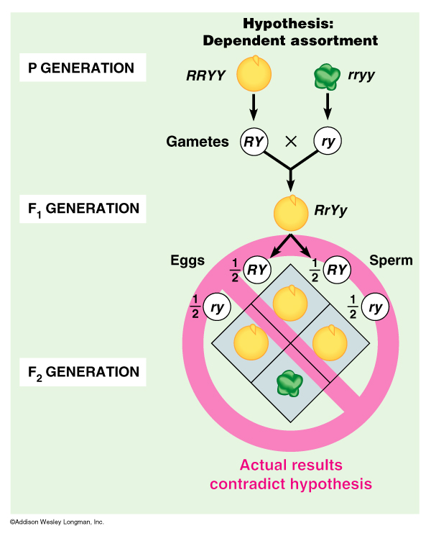
Dyhybrid Cross: Not what you’d expect.
In a Dihybrid cross a observes the inheritance of 2 traits at once.
You might expect the same 3:1 ratio, but this doesn’t occur.

Slide 35
Dihybrid Cross
RrYy x RrYy
Gametes ¼ RY, ¼ Ry, ¼ rY and ¼ ry
16 possible outcomes

Slide 36
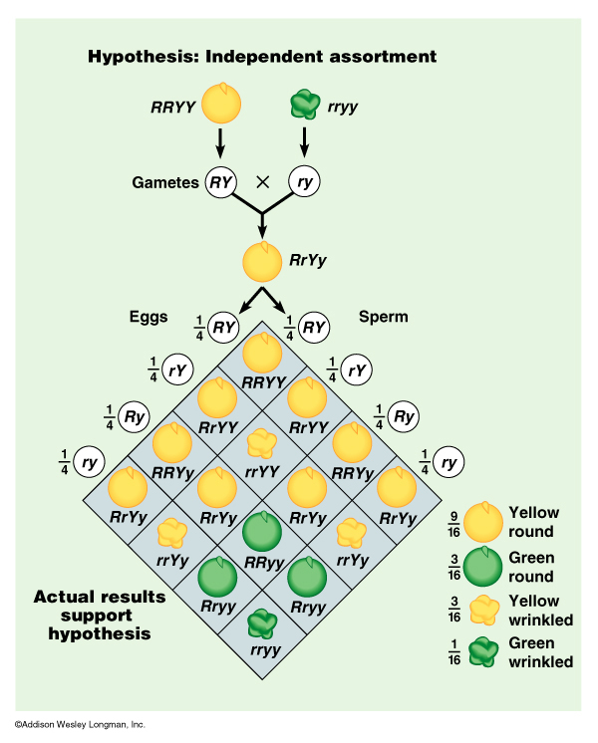
Dihybrid Results

Slide 37
Easier Way to do multiple traits
x
Do a separate Punnett Square for each trait
Rr x Rr Yy x Yy
R
r
Y
y
RR
Rr
Y
YY
Yy
R
r
Rr
rr
y
Yy
yy
3/4 Round
1/4 wrinkled
3/4 Yellow
1/4 green

Slide 38
Easier Way to do multiple traits
x
3/4 Round
1/4 wrinkled
3/4 Yellow
1/4 green
Muliply the probabilities of each trait
Round and Yellow = ¾ x ¾ = 9/16
Round and Green = ¾ x ¼ = 3/16
Wrinkled and Yellow = ¼ x ¾ = 3/16
Wrinkled and Green = ¼ x ¼ = 1/16

Slide 39
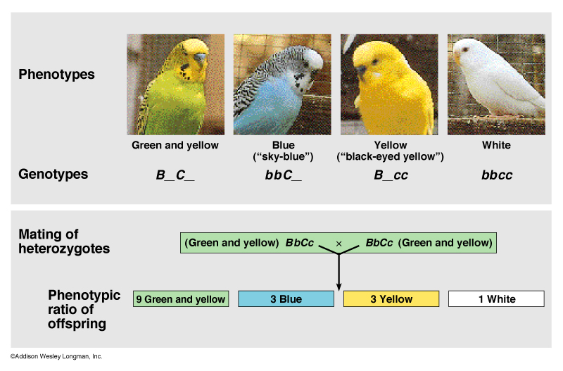
Dihybrid Cross in Parakeets

Slide 40
Test Cross
A Test Cross is done to determine the genotype of an individual with a dominant phenotype.
This individual is then crossed with a recessive phenotype (dd).
Any recessive offspring dd, proves the unknown is heterozygous.
D
?
d
D
d
?
d
d
D
d
?
d

Slide 41
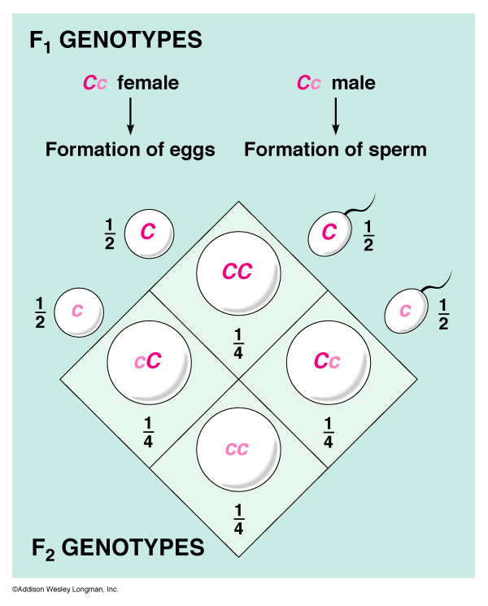
Mendel’s Principle’s and the Rules of Probability
The probability scale ranges from 0 (not going to happen) to 1(it should happen).
When tossing a coin the chances of it coming up heads is ½ and tails is also 1/2. In a deck of cards the chance of drawing a certain card, the Ace of Hearts, is 1/52.

Slide 42
Mendel’s Principle’s and the Rules of Probability
Each Coin Tossing is an independent event having a probability of ½.
Rule of Multiplication What is the chance that they will both land heads up?
  ½ x ½ = ¼

Slide 43
Rule of Addition
If an event can occur in two or more alternative ways the probabilities of each way occurring are simply added together. This is the rule of addition.
The probability of heads then tails is ¼ using the rule of multiplication, and the same is true of tails then heads.
¼ + ¼ = ½

Slide 44
video
#45(what are pedigree charts)

Slide 45
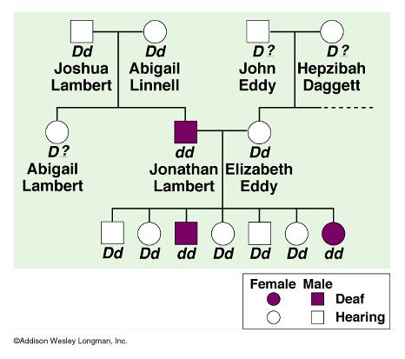
Pedigrees Track Human Traits
A pedigree is a chart showing a family tree and a trait that is present in the family.

Slide 46
Pedigrees Track Human Traits
Those individuals who are heterozygous, carry the recessive allele, but are not deaf and are called carriers.

Slide 47
Pedigrees Track Human Traits
Carriers are determined by their offspring. In this case, Jonathan and Abigail must have been carriers, because neither was deaf, but they produced a child, Jonathan, who was.

Slide 49
Pedigree
http://www.biology.arizona.edu/human_Bio/activities/blackett2/act_pedigree2.html
Carrier – an individual who is heterozygous, has dominant trait, but can pass on the recessive allele to offspring
Affected Female
Normal Male
Carrier Male
Affected Male
Normal Female
Carrier Female

Slide 50
Pedigree
?
?
?
?
?
?
?
?
?

Slide 51
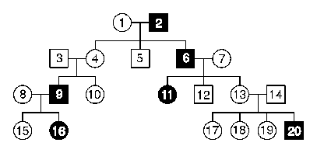
Pedigree A
1Can the trait shown in pedigree A be autosomal dominant? No
If you answered "no" to question 1 above, explain why by referring to specific individuals.
Dominant traits cannot “skip generations”
3 and 4 do not have the trait, but 9 does

Slide 52
Pedigree A
2. Can he trait shown in pedigree A be autosomal recessive? Yes
If you answered "no" to question 2 above, explain why by referring to specific individuals.

Slide 53
Pedigree A
3. Can he trait shown in pedigree A be X linked recessive? Probably not
If you answered "no" to question 3 above, explain why by referring to specific individuals.

Slide 54
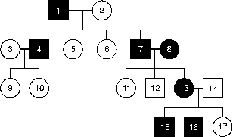
Pedigree B
4. Can the trait shown in pedigree B be autosomal dominant? Yes
If you answered "no" to question 4 above, explain why by referring to specific individuals.

Slide 55
Pedigree B
5. Can he trait shown in pedigree B be autosomal recessive?
If you answered "no" to question 5 above, explain why by referring to specific individuals.

Slide 56
Pedigree B
6. Can he trait shown in pedigree B be X linked recessive?
If you answered "no" to question 6 above, explain why by referring to specific individuals

Slide 57
Video #46 (Pedigree analysis no. 3)

Slide 58
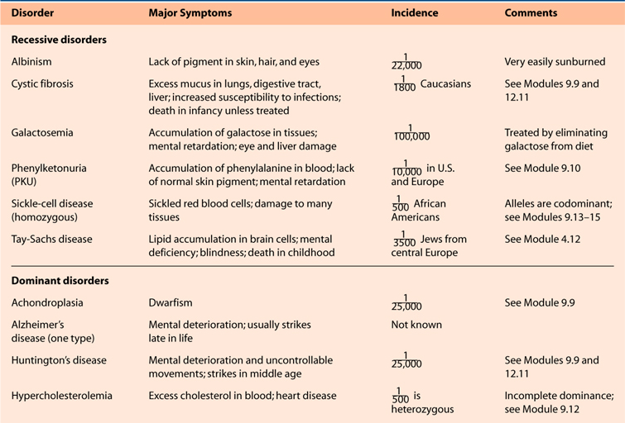
Dominant and Recessive Disorders in Humans

Slide 59
Recessive Traits
Recessive traits can appear to skip generations
Every generation must contain a carrier or it will not be passed on

Slide 60
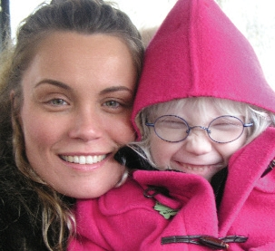
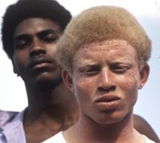
Albinism
Lack of pigment in the hair, skin and eyes

Slide 61
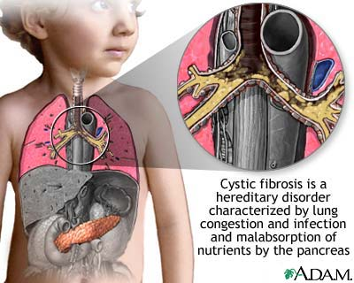
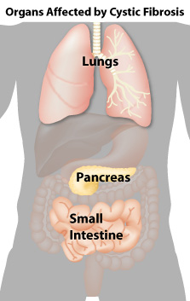
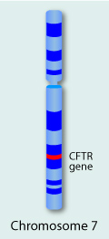
Cystic Fibrosis
1 in 20 Caucasians is a carrier, Cc
1/20 x 1/20 = 1/400 chance that both parents are carriers, Cc x Cc
¼ chance that offspring affected, cc
1/1600 caucasian babies have cystic fibrosis
Excess Mucus, clogs lungs, pancrease and small intestine

Slide 62
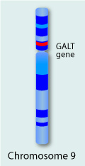
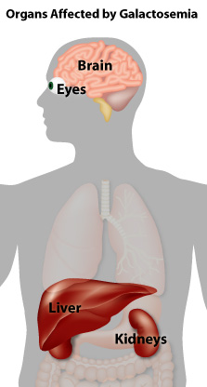
Galactosemia
Cannot digest galactose, a sugar found in milk
Cataracts, Mental retardation and other symptoms appear if galactose is not removed from the diet

Slide 63
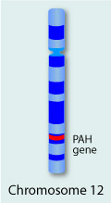
PKU
Phenylketonuria
1 in 10,000 to 20,000 births caucasians
Inability to digest phenylalanine
Can cause Mental Retardation and Seizures
Treated by limiting the amount of phenylalanine in the diet

Slide 64
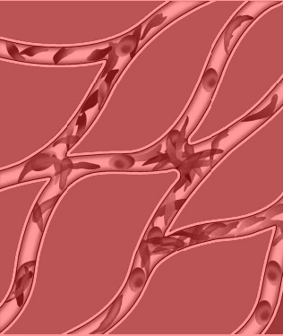
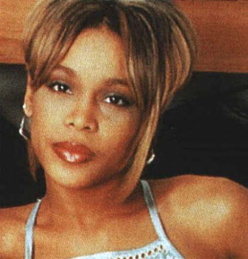
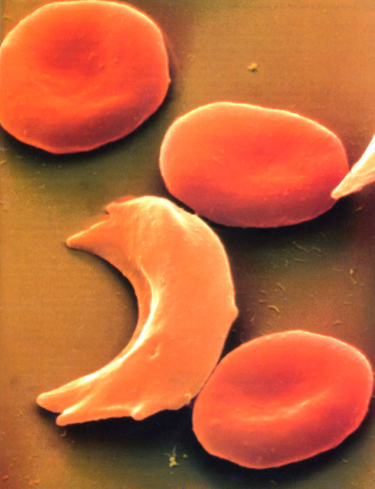
Sickle Cell Disease
Defective hemoglobin
Red Blood Cells deform when low in oxygen
Deformed cells cut off circulation
Heterozygous individuals have immunity to malaria

Slide 65
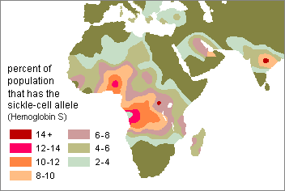

Slide 66
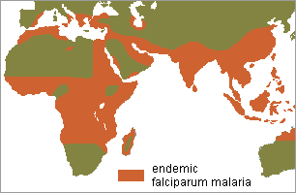

Slide 67
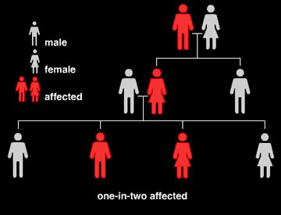
Dominant Disorders
Dominant disorders are only inherited if a parent has the disorder

Slide 68
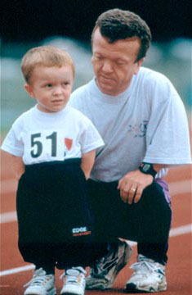
Achondroplasia
An inherited form of dwarfism
1 in 25,000 births of all races
Most common growth related birth defect

Slide 69
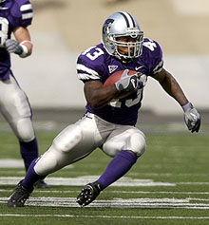
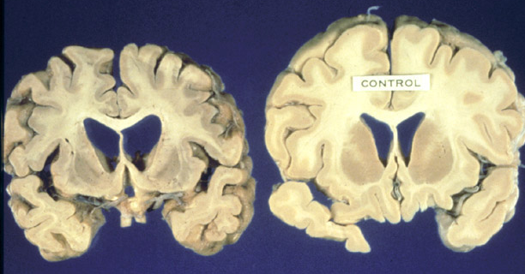
Huntington’s Disease
Deterioration of the Brain
Occurs in late 30’s to 50’s
8 people per 100,000

Slide 70
Complex Inheritance
Incomplete dominance – neither allele is completely dominant

Slide 71
Complex Inheritance
Incomplete dominance – neither allele is completely dominant

Slide 72
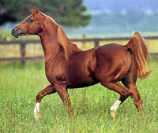
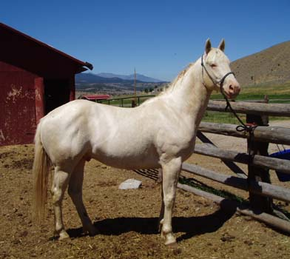
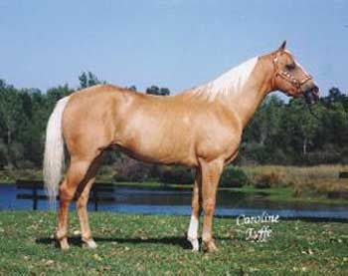
Palamino Horses
Heterozygous (Cc)
CC x cc always produces Cc palamino
X
CC
cc
Cc

Slide 73
Palamino x Palamino
Cc X Cc = 1 CC: 2 Cc : 1 cc
X
Cc
Cc
1/4
1/2
1/4
CC
Cc
cc

Slide 74
Codominance
Both alleles are expressed at the same time
Type AB blood is an example, both A and B antigens are present.

Slide 75
Multiple Alleles
ABO blood typing is also an example of multiple alleles.
Instead of 2 alleles there are I^{A}, I^{B} and I
  I^{A} codes for A proteins
  I^{B} codes for B proteins
  I codes for no proteins

Slide 76
Blood Types
Phenotype Genotype(s)
Type A I^{A}I^{A} or I^{A}i
Type B I^{B}I^{B} or I^{B}i
Type AB I^{A}I^{B}
Type O ii

Slide 77
http://www.redcrossblood.org/learn-about-blood/blood-types
Video #84(what are blood types)
Notes:
Me: A- (A+, O+) / Wife: A+ (A-, O+) / Lee? O+ / Zach: A- / Tyler: A-

Slide 78
Polygenic (Many genes)
Many traits come in many forms
  Height, Skin color, Hair color, Eye color
These are controlled by several genes

Slide 79
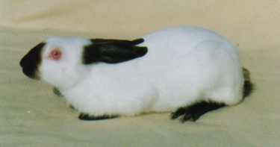
Environmental Factors
Some genes are affected by the environment
Himalayan Rabbit

Slide 80
Linked Genes
Linked genes are located on the same chromosome
This causes them to be inherited together
They can be separated by crossing over.

Slide 81
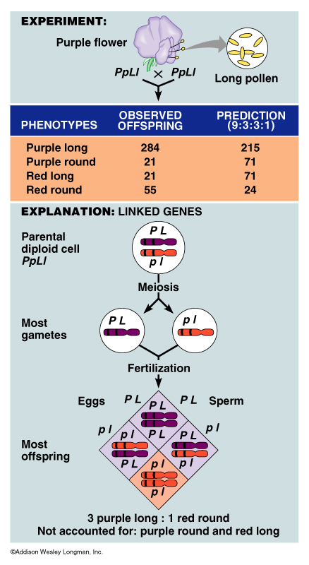

Slide 83
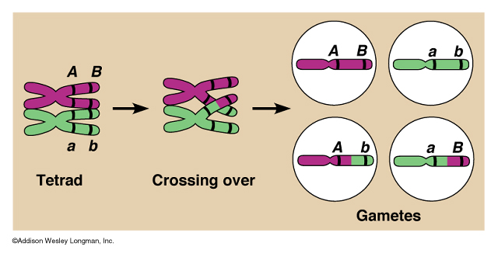
Linked Genes Can Be Separated
Crossing over (recombination) separates linked genes

Slide 84
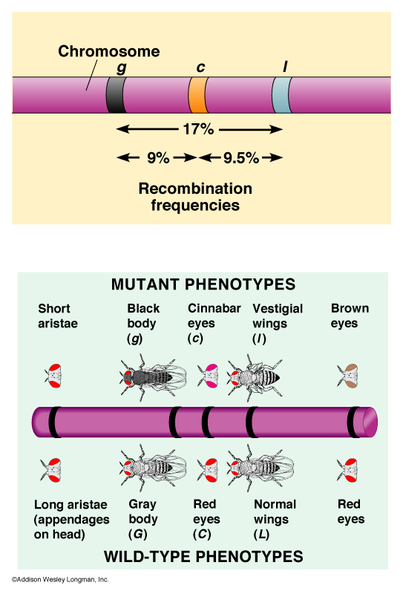
Mapping Genes
Genes that cross more often are further apart on a chromosome

Slide 85
Sex-Linked Traits
Traits that are located on the X chromosome are sex-linked (X-linked)
Sex Chromosomes
  XX female two X chromosomes one from each parent
  XY male only one copy of the X chromosome that was inherited from the mother

Slide 86
Sex Linked Traits
Sex Linked traits are usually recessive
A female can be a carrier Xx
In males xY they act similar to dominant traits.
  Red Green Colorblindness
  Hemophilia
  Duchenne Muscular Dystrophy

Slide 87

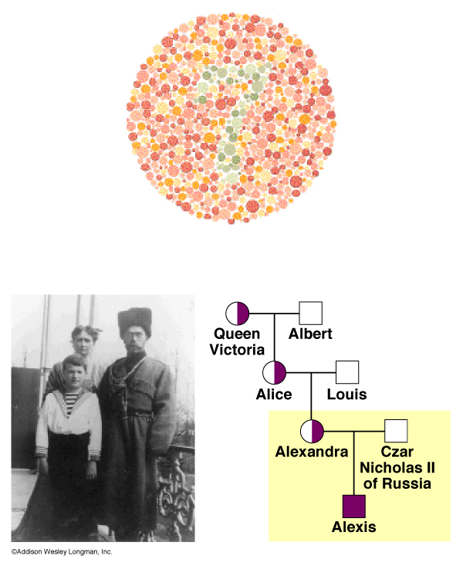
Red-Green Colorblindness
The inability to distinguish between red and green

Slide 88
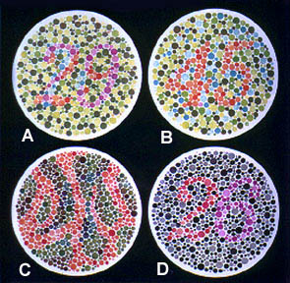
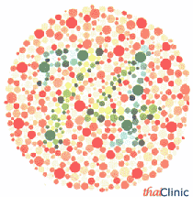

Slide 89
4 Sex-Linked Traits:
A: 29, B: 45, C: --, D: 26
1. Normal Color Vision:
A: 70, B: --, C: 5, D: --
2. Red-Green Color-Blind:
A: 70, B: --, C: 5, D: 6
3. Red Color-blind
A: 70, B: --, C: 5, D: 2
4. Green Color-Blind:

Slide 90


Slide 91


Hemophilia

Slide 92
Hemophilia
Heme – blood
Phile – Love
Hemophiliacs – blood does not clot, excessive bleeding
X-Linked Recessive – more common in males

Slide 93
Hemophilia
Heme – blood
Phile – Love
Hemophiliacs – blood does not clot, excessive bleeding
X-Linked Recessive – more common in males

Slide 94


Duchenne Muscular Dystrophy
Their muscle cells lack an essential substance so they gradually develop muscular weakness in infancy and will probably die in their mid 20s.

Slide 95
Calico Cats (Mosaics)
XX = female
At a stage in development each cell deactivates one of the chromosomes at random.
The deactivated X chromosome is called a Barr body

Slide 96
XX
X
XX
XX
X
X
XX
X
XX
X
XX
XX
X
X
XX
X
XX
X
XX
X
XX
X
XX
X
XX
X
XX
X
XX
X
XX
X
XX
X
XX
X
XX
X

Slide 97


Slide 98
Male Calico Cats
XXY – “kitty Klinefelter’s”

