Slide 1
Heart Unit

Slide 2
Patterns of Symmetry
Radial: similar parts branch out in all directions from the central line
  Ex: sea anemones, jelly fish, hydra
Dorsal: Top (shark fin)
Ventral: Bottom (belly)
Anterior: “head”
Posterior: “tail”

Slide 3
Bilateral Symmetry: similar halves on either side
Cephalization: concentration of sensory and brain structures in anterior end
    Usually bilateral animals
    Leads with head; sensing danger, prey, or potential mate

Slide 4
Diagram
http://www.sumanasinc.com/webcontent/animations/content/human_heart.html

Slide 5
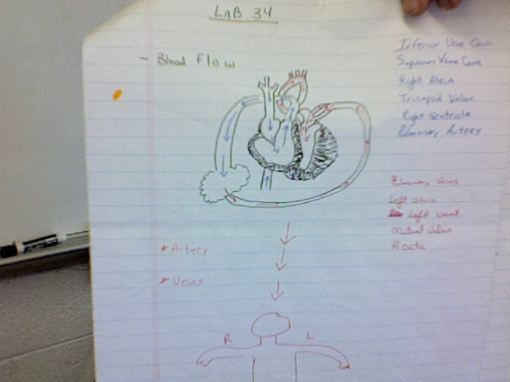

Slide 6
Heart Terms
Inferior Vena Cava
Superior Vena Cava
Right Atria
Tricupsid Valve
Right Ventricle
Pulmonary Artery
Pulmonary Veins
Left Atria
Left Ventricle
Mitral Valve
Aorta
Arttery: Blood away from heart
Veins: Blood to the heart

Slide 7
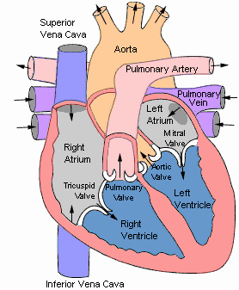

Slide 8
Chapter 23 Circulation
Circulatory system transports substances throughout the body
  CO₂ – O₂
  Nutrients – Wastes
  Immune Cells

Slide 9
Vessels
Arteries – carry blood away from the heart
Capillaries – allow cells to pass through in single file, thin walls allow diffusion of materials
Veins - carry blood back to the heart

Slide 10
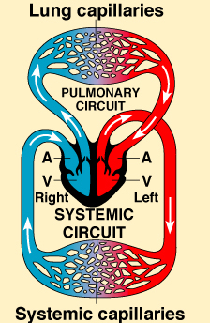
Dual Circuit System
Pulmonary Circuit – Heart to the Lungs and Back to the heart
To pick up oxygen
Systemic Circuit – Carries oxygen to the body

Slide 11
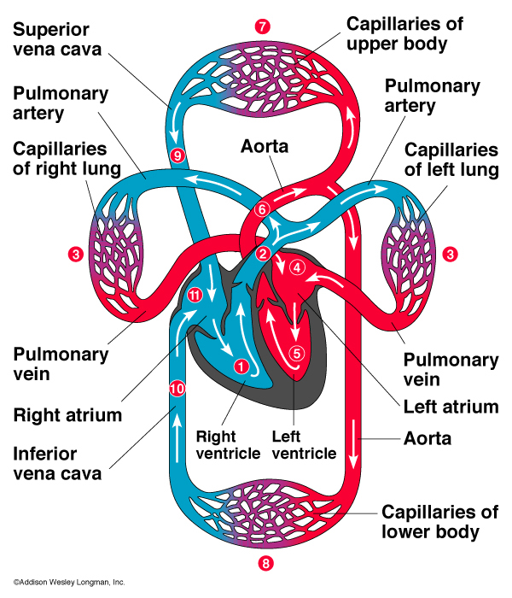
Heart
Right Atrium
Right Ventricle
Lungs
Left Atrium
Left Ventricle
To Body

Slide 12
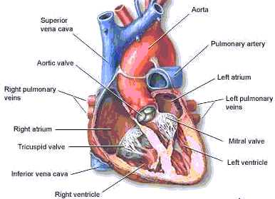
Interventricular
Septum
Chordae tendineae

Slide 13
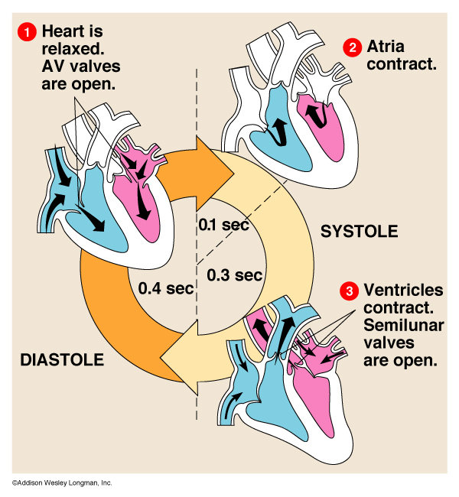
Heart Cycle
Diastole – Heart is relaxed
Blood fills the heart
Systole
Atria contract
Ventricles contract

Slide 14
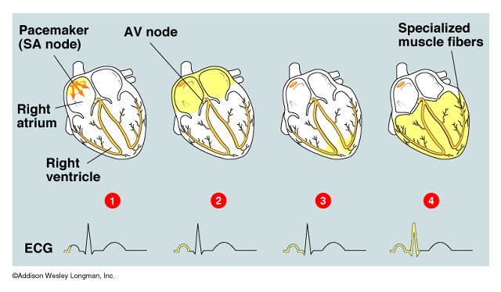
Pacemaker
Sinoatrial (SA) node – starts the systolic cycle by contracting the atria
Atrioventricular (AV) node – signals the contraction of the ventricles

Slide 15
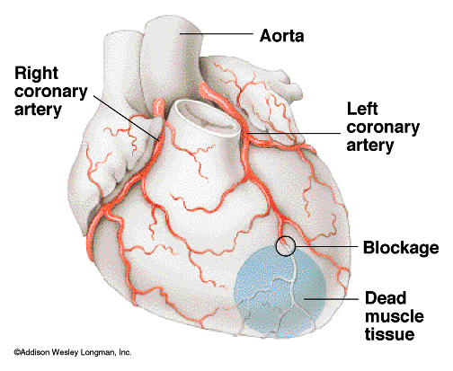
Heart Attack
A coronary artery is blocked
The tissue fed by that artery runs out of oxygen
The tissue dies if blood flow isn’t restored

Slide 16
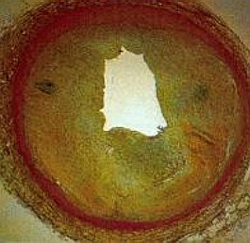
Atherosclerosis
Arteries become clogged with plaque
Plaque – white substance that fills the arteries and clogs
http://server.activeweb.pl/images/atherosclerosis.jpg

Slide 17
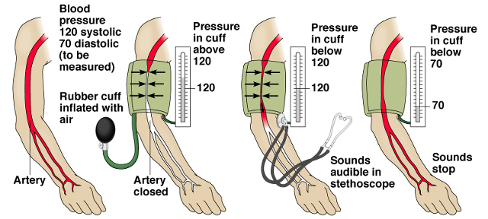
Blood Pressure
Systolic Pressure – pressure during the heart contraction
Diastolic Pressure – Pressure when heart is relaxed
Systolic
Diastolic

Slide 18
Hypertension
Normal Blood Pressure 120/80
High Blood Pressure 140/90 or higher

Slide 19
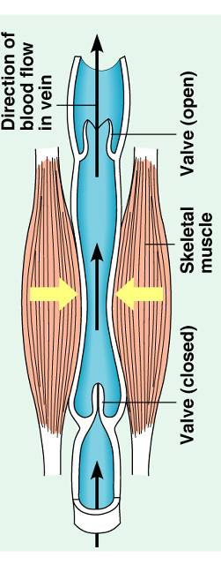
Blood Flow in the Veins
Pressure is high in the arteries
Very low in the capillaries
There is little pressure to push the blood back to the heart
Veins have valves to prevent backward flow
Muscle contractions push blood toward heart

Slide 20
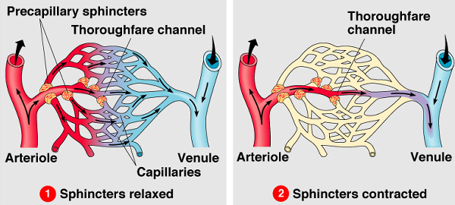
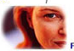
Distribution of the blood
Capillaries have sphincters of smooth muscle
These control the blood flow in the capillaries
http://www.highgatehospital.co.uk/images/blushing.jpg

Slide 21
Blood
55% Plasma – liquid
Water, Salts, Proteins
45% cellular
Red Blood Cells – Oxygen
White Blood Cells – Immune system
Platelets - Clotting

Slide 22
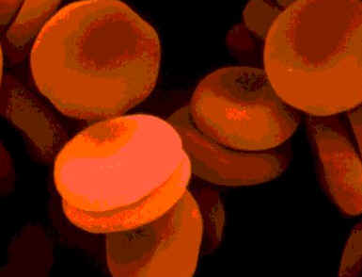
Red Blood Cells
http://www.jdaross.mcmail.com/images/erythrocytes.jpg
Erythrocytes – “ red cells”
Lose nucleus when mature –
more surface area
Carry Oxygen
Hemoglobin 5-6 million/ mm³
Anemia – low red blood cells

Slide 23
Lab
http://www.biologyjunction.com/sheep_heart_dissection_lab_repor.htm
http://www.biologycorner.com/anatomy/circulatory/heart/heart_dissection.html
http://www.hometrainingtools.com/a/heart-dissection-project

Slide 24
Videos #61 (heart bypass surgery)

